Slide 1
OSPF
Multi-Area OSPF
Module 1

Slide 2
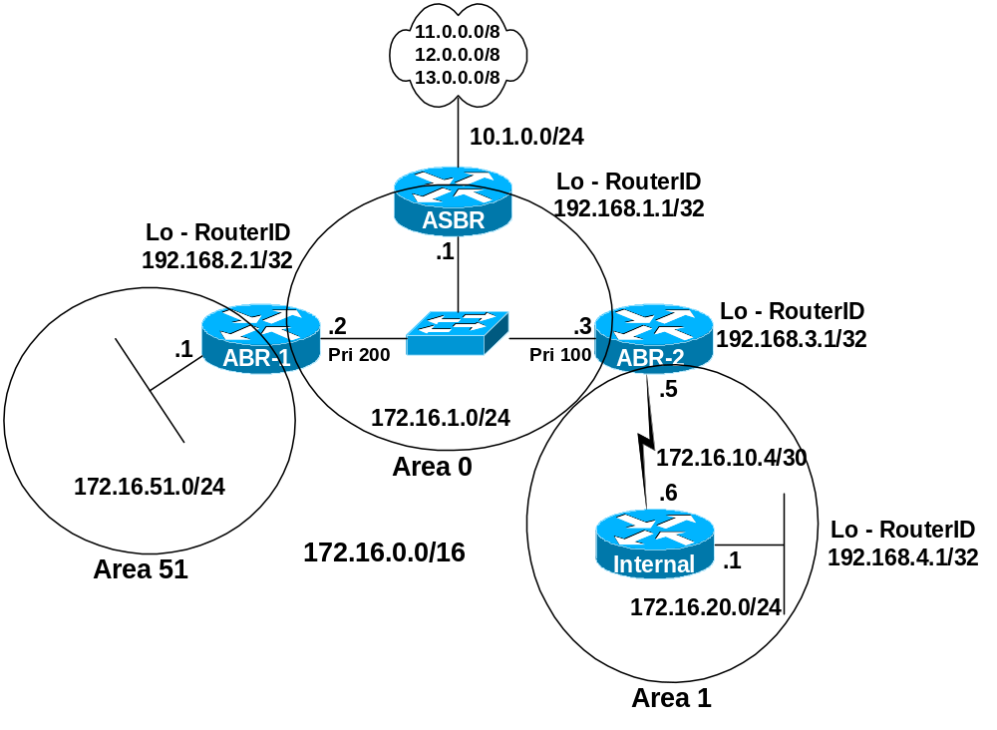
Part I - LSAs using all normal areas
Multi Area OSPF
Normal Areas
Rick Graziani graziani@cabrillo.edu

Slide 3
Topics
Areas
LSAs
show ip ospf database (summary of link state database)
show ip route
Stub Areas
Totally Stubby Areas
E1 and E2 routes
Default Routes
Route Summarization
NSSA (Not So Stubby Areas)
Multiple ABR Scenario
Multiple ASBR Scenario
Virtual Links
Load Balancing
show commands
Rick Graziani graziani@cabrillo.edu

Slide 4
Issues with large OSPF nets
Large link-state table
  Each router maintains a LSDB for all links in the area
  The LSDB requires the use of memory
Frequent SPF calculations
  A topology change in an area causes each router to re-run SPF to rebuild the SPF tree and the routing table.
  A flapping link will affect an entire area.
  SPF re-calculations are done only for changes within that area.
Large routing table
  Typically, the larger the area the larger the routing table.
  A larger routing table requires more memory and takes more time to perform the route look-ups.
Solution: Divide the network into multiple areas
Rick Graziani graziani@cabrillo.edu

Slide 5
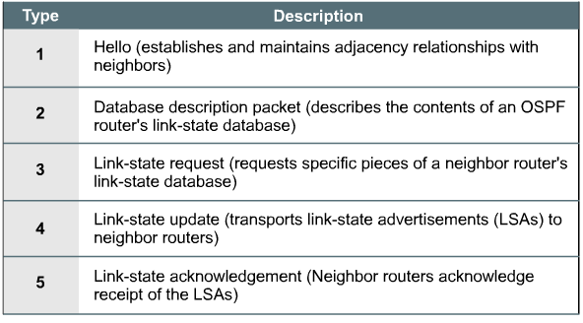
OSPF Packet Types
OSPF packet types
Rick Graziani graziani@cabrillo.edu

Slide 6
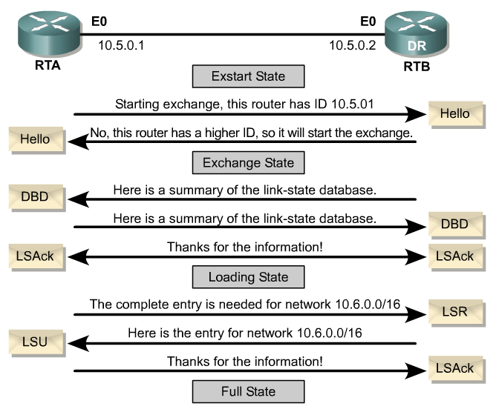
LSAs used for discovering routes and reaching Full State, along with Maintain Routes
LSA Types
Rick Graziani graziani@cabrillo.edu

Slide 7
OSPF Type 4 - Link State Advertisements
We now will look at OSPF Type 4 packets more closely
OSPF packet types
Rick Graziani graziani@cabrillo.edu

Slide 8
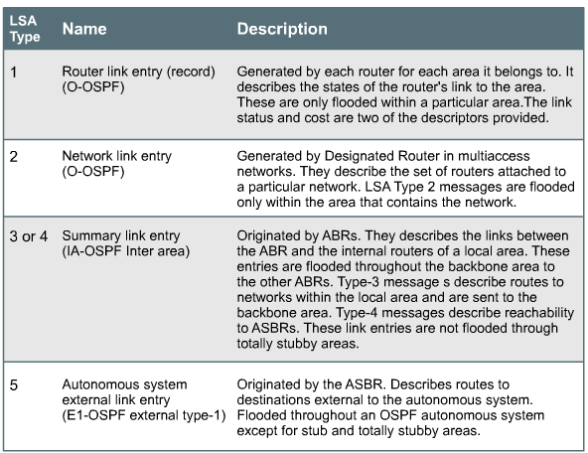
OSPF packet types
OSPF Type-4 packets have 7 LSA packets (later)
Rick Graziani graziani@cabrillo.edu

Slide 9
LSA Types
LSA Types 1 through 5
We will look at these in detail as we discuss areas in this module.
LSA Type 7 NSSA External Link Entry
Originated by an ASBR connected to an NSSA.
Type 7 messages can be flooded throughout NSSAs and translated into LSA Type 5 messages by ABRs.
Routes learned via Type-7 LSAs are denoted by either a “N1” or and “N2” in the routing table. (Compare to E1 and E2).
We will discuss this more later when we look at NSSA areas.
Rick Graziani graziani@cabrillo.edu

Slide 10
Area Types
Standard or Normal Areas
  Backbone
  Non-Backbone
Stub
  Stub Area
  Totally Stubby Area (TSA)
  Not-so-stubby-area (NSSA)
Rick Graziani graziani@cabrillo.edu

Slide 11
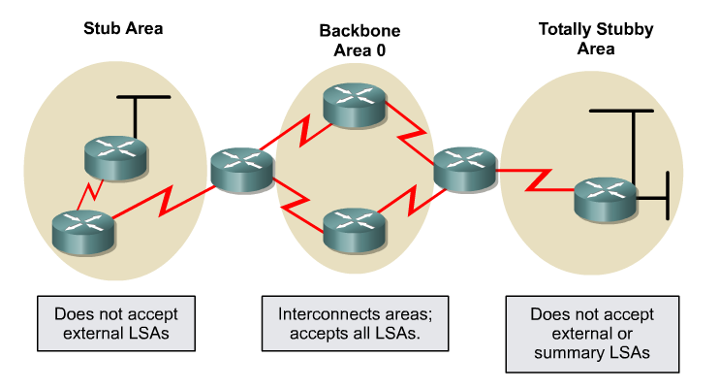
Area Types
Rick Graziani graziani@cabrillo.edu

Slide 12
Part I - LSAs using all normal areas
Multi Area OSPF
Normal Areas
Rick Graziani graziani@cabrillo.edu

Slide 13
Part I - LSAs using all normal areas
Routes Received on all OSPF Routers
Overview of Normal Areas – This will all be explained!
Receives all routes from within A.S.:
Within the local area – LSA 1 and LSA 2
From other areas (Inter-Area) – LSA 3, LSA 4, LSA 5
Receives all routes from External A.S.’s (External AS means routes not from this OSPF routing domain):
From external AS’s – LSA 5
As long as routes are being redistributed by the ASBR (more later)
Default Routes
Received only if default-information-originate command was used (later)
If default-information-originate command is not used, then the default route is not received
Rick Graziani graziani@cabrillo.edu

Slide 14
1. OSPF Multi-Areas - All Normal Areas
ASBR
router ospf 1
redistribute static
network 172.16.1.0 0.0.0.255 area 0
!
ip classless
ip route 11.0.0.0 255.0.0.0 Null0
ip route 12.0.0.0 255.0.0.0 Null0
ip route 13.0.0.0 255.0.0.0 Null0
ABR-1
interface FastEthernet0/0
ip address 172.16.1.2 255.255.255.0
ip ospf priority 200
router ospf 1
network 172.16.1.0 0.0.0.255 area 0
network 172.16.51.0 0.0.0.255 area 51
ABR-2
interface FastEthernet0
ip address 172.16.1.3 255.255.255.0
ip ospf priority 100
!
router ospf 1
network 172.16.1.0 0.0.0.255 area 0
network 172.16.10.4 0.0.0.3 area 1
Internal
router ospf 1
network 172.16.0.0 0.0.255.255 area 1
ABR contains network statements for each area it belongs to, using the proper area value.
Rick Graziani graziani@cabrillo.edu

Slide 15
Understanding LSAs
show ip ospf database
  This is not the link state database, only a summary.
  It is a tool to help determine what routes are included in the routing table.
  We will look at this output to learn the tool as well as become familiar with the different types of LSAs.
  To view the link state database use: show ip ospf database [router|network|…]
LSA Header
0 1 2 3
0 1 2 3 4 5 6 7 8 9 0 1 2 3 4 5 6 7 8 9 0 1 2 3 4 5 6 7 8 9 0 1
+-+-+-+-+-+-+-+-+-+-+-+-+-+-+-+-+-+-+-+-+-+-+-+-+-+-+-+-+-+-+-+-+
| LS age | Options | LS type |
+-+-+-+-+-+-+-+-+-+-+-+-+-+-+-+-+-+-+-+-+-+-+-+-+-+-+-+-+-+-+-+-+
| Link State ID |
+-+-+-+-+-+-+-+-+-+-+-+-+-+-+-+-+-+-+-+-+-+-+-+-+-+-+-+-+-+-+-+-+
| Advertising Router |
+-+-+-+-+-+-+-+-+-+-+-+-+-+-+-+-+-+-+-+-+-+-+-+-+-+-+-+-+-+-+-+-+
| LS sequence number |
+-+-+-+-+-+-+-+-+-+-+-+-+-+-+-+-+-+-+-+-+-+-+-+-+-+-+-+-+-+-+-+-+
| LS checksum | length |
+-+-+-+-+-+-+-+-+-+-+-+-+-+-+-+-+-+-+-+-+-+-+-+-+-+-+-+-+-+-+-+-+
Rick Graziani graziani@cabrillo.edu

Slide 16
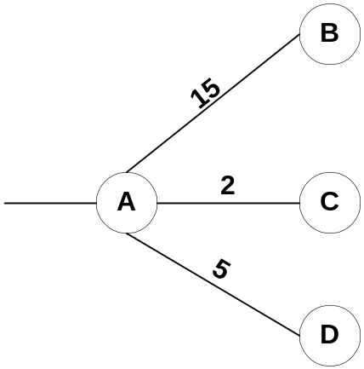
LSA 1 - Router Link States
LSA 1 – Router LSA
Generated by each router for each area it belongs to.
Describes the states of the links in the area to which this router belongs.
Tells the other routers in the area about itself and its links to adjacent OSPF routers, and “leaf networks.”
Flooded only within the area. On multi-access networks, sent to the DR.
Denoted by just an “O” in the routing table or “C” if the network is directly connected.
ABR will include a set of LSA 1’s for each area it belongs to.
“Leaf” network
Router A’s LSA 1s which are flooded to all other routers in this area.
Rick Graziani graziani@cabrillo.edu

Slide 17
LSA 1 - Router Link States
Multi Area OSPF
Normal Areas
LSA 1’s being sent within Area 0
LSA 1
LSA 1
LSA 1
Rick Graziani graziani@cabrillo.edu

Slide 18
LSA 1 - Router Link States
LSA 1’s being sent within other areas
Multi Area OSPF
Normal Areas
LSA 1
LSA 1
LSA 1
LSA 1
Rick Graziani graziani@cabrillo.edu

Slide 19
LSA 1 - Router Link States
Multi Area OSPF
Normal Areas
LSA 1’s are flooded out other interfaces within the same area.
LSA 1 Originated
LSA 1 flooded
Rick Graziani graziani@cabrillo.edu

Slide 20
LSA 1 - Router Link States
For Router Links:
The Link State ID is always the same as the Advertising Router
Advertising Router is the Router ID of the router that created this LSA 1
Internal#show ip ospf data
OSPF Router with ID (192.168.4.1) (Process ID 1)
Router Link States (Area 1) <- Note the Area!
(LSA 1 - Links in the area to which this router belongs.)
Link ID ADV Router Age Seq# Checksum Link count
192.168.3.1 192.168.3.1 898 0x80000003 0xCE56 2
192.168.4.1 192.168.4.1 937 0x80000003 0xFD44 3
Bottom line: Router Link States (LSA1’s) should display all the RouterIDs of routers in that area, including its own.
Rick’s reminder: LSA 1 -> “my one area”
Rick Graziani graziani@cabrillo.edu

Slide 21
LSA 1 - Router Link States
ABR-2#show ip ospf data
OSPF Router with ID (192.168.3.1) (Process ID 1)
Router Link States (Area 1) <- Note the Area!
(LSA 1 - Links in the area to which this router belongs.)
Link ID ADV Router Age Seq# Checksum Link count
192.168.3.1 192.168.3.1 786 0x80000003 0xCE56 2
192.168.4.1 192.168.4.1 828 0x80000003 0xFD44 3
Bottom line: Router Link States (LSA1’s) should display all the RouterIDs of routers in that area, including its own.
Rick’s reminder: LSA 1 -> “my one area”
Rick Graziani graziani@cabrillo.edu

Slide 22
LSA 1 - Router Link States
ABR-2 - show ip route
172.16.0.0/16 is variably subnetted, 4 subnets, 3 masks
O IA 172.16.51.1/32 [110/2] via 172.16.1.2, 00:11:44, FastEthernet0
O 172.16.20.0/24 [110/782] via 172.16.10.6, 00:12:29, Serial0
C 172.16.10.4/30 is directly connected, Serial0
C 172.16.1.0/24 is directly connected, FastEthernet0
O E2 11.0.0.0/8 [110/20] via 172.16.1.1, 00:11:44, FastEthernet0
O E2 12.0.0.0/8 [110/20] via 172.16.1.1, 00:11:44, FastEthernet0
O E2 13.0.0.0/8 [110/20] via 172.16.1.1, 00:11:44, FastEthernet0
192.168.3.0/32 is subnetted, 1 subnets
C 192.168.3.1 is directly connected, Loopback1
Denoted by just an “O” in the routing table, or a “C”
Why is there only just an”O” for this network and not the other networks?
  Directly connected or via another area.
Rick Graziani graziani@cabrillo.edu

Slide 23
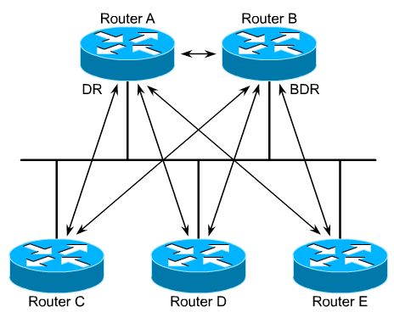
LSA 2 - Network Link States
LSA 2 – Network LSA
Generated by the DR on every multi-access network
Denoted by just an “O” in the routing table or “C” if the network is directly connected.
Flooded only within the originating area.
LSA 2’s are in link state database for all routers within area, even those routers on not on multi-access networks or DRs on other multi-access networks in the same area.
ABR may include a set of LSA 2s for each area it belongs to.
Rick Graziani graziani@cabrillo.edu

Slide 24
LSA 2 - Network Link States
No LSA 2’s for ABR-1 in Area 51, or for Internal because no other routers on multi-access segment.
Multi Area OSPF
Normal Areas
LSA 2
DR
LSA 2
LSA 2
flooded
LSA 2
LSA 2
flooded
DR
Rick Graziani graziani@cabrillo.edu

Slide 25
LSA 2 - Network Link States
ASBR#show ip ospf data
OSPF Router with ID (192.168.1.1) (Process ID 1)
Net Link States (Area 0)
(LSA 2 - Generated by the DR)
Link ID ADV Router Age Seq# Checksum
172.16.1.2 192.168.2.1 201 0x8000000D 0xCFE8
Link ID 172.16.1.2 = IP address of DR on MultiAccess Network
ADV Router 192.168.2.1 = Router ID of DR
Bottom line: Net Link States (LSA2’s) should display the RouterIDs of the DRs on all multi-access networks in the area and their IP addresses.
Rick’s reminder: LSA 2 -> “Ethernet = Layer 2 or D R”
1 2
Rick Graziani graziani@cabrillo.edu

Slide 26
LSA 3 – Summary Net Link States
LSA 3 – Summary LSA
Originated by the ABR.
Describes links between ABR and Internal Routers of the Local Area
ABR will include a set of LSA 3’s for each area it belongs to.
LSA 3s are flooded throughout the backbone (Area 0) and to other ABRs.
Routes learned via LSA type 3s are denoted by an “IA” (Inter-area) in the routing table.
Rick Graziani graziani@cabrillo.edu

Slide 27
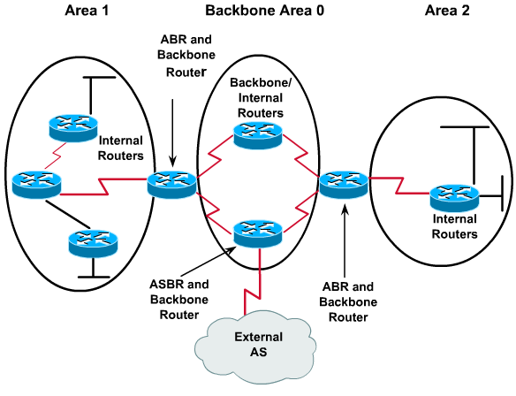
LSA 3 – Summary Net Link States
Rick Graziani graziani@cabrillo.edu

Slide 28
LSA 3 – Summary Net Link States
LSA 1’s are sent as LSA 3’s into other areas by the ABRs.
Multi Area OSPF
Normal Areas
LSA 1
LSA 1
LSA 1
LSA 3
LSA 3
Rick Graziani graziani@cabrillo.edu

Slide 29
LSA 3 – Summary Net Link States
Multi Area OSPF
Normal Areas
LSA 1’s are sent as LSA 3’s into other areas by the ABRs.
LSA 3
LSA 3
LSA 3
LSA 1
LSA 3
LSA 1
LSA 3
LSA 1
LSA 1
LSA 3
Rick Graziani graziani@cabrillo.edu

Slide 30
Multi Area OSPF
Normal Areas
LSA 1’s are sent as LSA 3’s into other areas by the ABRs.
LSA 3
LSA 3
LSA 3
LSA 1
LSA 3
LSA 1
LSA 3
LSA 1
LSA 1
LSA 3
Area 1
Routers only see the topology of the area they belong to.
When a link in one area changes, the adjacent routers originate in LSA 1’s and flood them within the area, causing intra-area (internal) routers to re-run the SPF and recalculating the routing table.
ABRs do not announce topological information between areas.
ABRs only inject routing information into other areas, which is basically a distance-vector technique.
Rick Graziani graziani@cabrillo.edu

Slide 31
LSA 1’s are sent as LSA 3’s into other areas by the ABRs.
Multi Area OSPF
Normal Areas
LSA 3
LSA 3
LSA 3
LSA 1
LSA 3
LSA 1
LSA 3
LSA 1
LSA 1
LSA 3
Area 1
ABRs calculate intra-area routes for directly attached areas and announce them to all other areas as inter-area routes, using LSA 3’s.
OSPF ABRs will only announce inter-area routes that were learned from the backbone area, area 0.
The backbone area serves as a repository for inter-area routes.
This keeps OSPF safe from routing loops.
Rick Graziani graziani@cabrillo.edu

Slide 32
LSA 3 – Summary Net Link States
Multi Area OSPF
Normal Areas
Don’t forget about the LSA 1’s from Area 0.
LSA 1
LSA 1
LSA 1
LSA 3
LSA 3
Rick Graziani graziani@cabrillo.edu

Slide 33
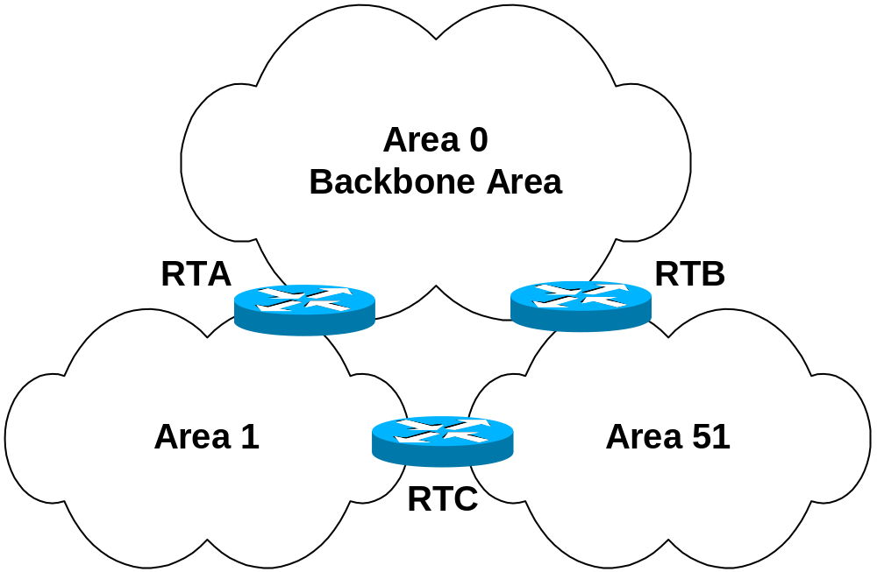
Normal Areas
LSA 1’s
LSA 3
LSA 3
Not ABR
ABRs calculate intra-area routes for directly attached areas and announce them to all other areas as inter-area routes, using LSA 3’s.
In normal operation, OSPF ABRs will only announce inter-area routes that were learned from the backbone area, area 0.
RTC does not forward LSA 3’s from Area 1 to Area 51, and does not forward LSA 3’s from Area 51 to Area 1.
The backbone area serves as a repository for inter-area routes.
This keeps OSPF safe from routing loops.
Rick Graziani graziani@cabrillo.edu

Slide 34
LSA 3 – Summary Net Link States
Multi Area OSPF
Normal Areas
Rick Graziani graziani@cabrillo.edu

Slide 35
LSA 3 – Summary Net Link States
ASBR
ASBR# show ip ospf database
Summary Net Link States (Area 0)
Link ID ADV Router Age Seq# Checksum
(Area 1 networks - Advertising Router ABR-2)
172.16.10.4 192.168.3.1 278 0x80000001 0xD126
172.16.20.0 192.168.3.1 278 0x80000001 0xA746
(Area 51 networks - Advertising Router ABR-1)
172.16.51.1 192.168.2.1 206 0x80000005 0xA832
Link ID = IP network addresses of networks in other areas
ADV Router = ABR Router ID sending the LSA-3
Divided by ABR
Bottom line: Should see networks in other areas and the ABR advertising that route.
Rick’s reminder: LSA 3 -> “networks sent by the A B R”
1 2 3
Rick Graziani graziani@cabrillo.edu

Slide 36
LSA 3 – Summary Net Link States
ASBR
ASBR# show ip route
172.16.0.0/16 is variably subnetted, 4 subnets, 3 masks
O IA 172.16.51.1/32 [110/2] via 172.16.1.2, 00:02:54, FastEthernet0/0
O IA 172.16.20.0/24 [110/783] via 172.16.1.3, 00:02:54, FastEthernet0/0
O IA 172.16.10.4/30 [110/782] via 172.16.1.3, 00:02:54, FastEthernet0/0
C 172.16.1.0/24 is directly connected, FastEthernet0/0
10.0.0.0/24 is subnetted, 1 subnets
C 10.1.0.0 is directly connected, FastEthernet0/1
S 11.0.0.0/8 is directly connected, Null0
S 12.0.0.0/8 is directly connected, Null0
192.168.1.0/32 is subnetted, 1 subnets
C 192.168.1.1 is directly connected, Loopback0
S 13.0.0.0/8 is directly connected, Null0
Routes learned via LSA type 3s are denoted by an “IA” (Inter-Area Routes) in the routing table.
Rick Graziani graziani@cabrillo.edu

Slide 37
Another example: non-area 0 router, Internal
Internal# show ip ospf database
LSA 3 - Generated by the ABR. Describes links between ABR and
Internal Routers of the Local Area
(Area 51 networks - Advertising Router ABR-2)
Summary Net Link States (Area 1)
Link ID ADV Router Age Seq# Checksum
172.16.1.0 192.168.3.1 848 0x80000005 0xD339
172.16.51.1 192.168.3.1 843 0x80000001 0xB329
Internal# show ip route
172.16.0.0/16 is variably subnetted, 4 subnets, 3 masks
O IA 172.16.51.1/32 [110/783] via 172.16.10.5, 00:13:48, Serial0
C 172.16.20.0/24 is directly connected, FastEthernet0
C 172.16.10.4/30 is directly connected, Serial0
O IA 172.16.1.0/24 [110/782] via 172.16.10.5, 00:13:53, Serial0
192.168.4.0/32 is subnetted, 1 subnets
C 192.168.4.1 is directly connected, Loopback0
O E2 11.0.0.0/8 [110/20] via 172.16.10.5, 00:14:41, Serial0
O E2 12.0.0.0/8 [110/20] via 172.16.10.5, 00:14:41, Serial0
O E2 13.0.0.0/8 [110/20] via 172.16.10.5, 00:14:42, Serial0
Rick Graziani graziani@cabrillo.edu

Slide 38
LSA 4 – ASBR Summary Link States
LSA 4 – ASBR Summary LSA
Originated by the ABR.
Flooded throughout the backbone area to the other ABRs.
Describes the reachability to the ASBRs
Advertises an ASBR (Router ID) not a network
Included in routing table as an “IA” route.
Same format as a LSA 3 - Summary LSA, except LSA 4 ASBR Summary LSA the Network Mask field is always 0
Exceptions
Not flooded to Stub and Totally Stubby networks.
More on this later
Rick Graziani graziani@cabrillo.edu

Slide 39
Normal Areas
LSA 5’s flooded
LSA 4
LSA 4
LSA 4
LSA 4
Area 1
Flooded throughout the backbone area to the other ABRs.
Describes the reachability to the ASBRs
How do the ABRs know about the ASBR?
When routers receive an LSA 5 (AS External LSA) with external route information, the routers denote the Router ID being the ASBR.
Rick Graziani graziani@cabrillo.edu

Slide 40
LSA 4 – ASBR Summary Link States
ABR-2
ABR-2# show ip ospf database
Summary ASB Link States (Area 1)
LSA 4 - Reachability to ASBR.
Not flooded to Stub and Totally Stubby networks.
Link ID ADV Router Age Seq# Checksum
192.168.1.1 192.168.3.1 801 0x80000003 0x93CC
Link ID 192.168.1.1 = Router ID of ASBR
ADV Router 192.168.3.1 = Router ID ABR advertising route
Bottom line: Routers in non-area 0, should see Router ID of ASBR and its ABR to get there .
Rick’s reminder: LSA 4 -> “Reachability to the A S B R”
1 2 3 4
Rick Graziani graziani@cabrillo.edu

Slide 41
LSA 4 – ASBR Summary Link States
Internal
Internal# show ip ospf database
Summary ASB Link States (Area 1)
LSA 4 - Reachability to ASBR.
Not flooded to Stub and Totally Stubby networks.
Link ID ADV Router Age Seq# Checksum
192.168.1.1 192.168.3.1 912 0x80000003 0x93CC
Link ID 192.168.1.1 = Router ID of ASBR
ADV Router 192.168.3.1 = Router ID ABR advertising route
Note: No LSA 4s for Area 0 on Router B
Rick Graziani graziani@cabrillo.edu

Slide 42
LSA 5 - AS External Link States
LSA 5 – AS External LSA
Originated by the ASBR.
Describes destination networks external to the Autonomous System (This OSPF Routing Domain)
Flooded throughout the OSPF AS except to stub and totally stubby areas
Denoted in routing table as E1 or E2 (default) route (soon)
We will discuss default routes later.
ASBR – Router which “redistributes” routes into the OSPF domain.
Exceptions
Not flooded to Stub and Totally Stubby networks.
More on this later
Rick Graziani graziani@cabrillo.edu

Slide 43
Normal Areas
ASBR
router ospf 1
redistribute static
network 172.16.1.0 0.0.0.255 area 0
ip route 11.0.0.0 255.0.0.0 Null0
ip route 12.0.0.0 255.0.0.0 Null0
ip route 13.0.0.0 255.0.0.0 Null0
Rick Graziani graziani@cabrillo.edu

Slide 44
ASBR
router ospf 1
redistribute static
network 172.16.1.0 0.0.0.255 area 0
ip route 11.0.0.0 255.0.0.0 Null0
ip route 12.0.0.0 255.0.0.0 Null0
ip route 13.0.0.0 255.0.0.0 Null0
Normal Areas
LSA 5’s flooded
LSA 5
LSA 5
LSA 5
LSA 5
LSA 5
“Redistribute” command creates an ASBR router.
Originated by the ASBR.
Describes destination networks external to the OSPF Routing Domain
Flooded throughout the OSPF AS except to stub and totally stubby areas
Rick Graziani graziani@cabrillo.edu

Slide 45
LSA 5 - AS External Link States
ABR-2
ABR-2# show ip ospf database
AS External Link States <- Note, NO Area!
LSA 5 - External Networks originated by the ASBR,
Flooded throughout A.S. except to Stub and Totally Stubby
Link ID ADV Router Age Seq# Checksum Tag
11.0.0.0 192.168.1.1 1191 0x80000001 0x3FEA 0
12.0.0.0 192.168.1.1 1191 0x80000001 0x32F6 0
13.0.0.0 192.168.1.1 1191 0x80000001 0x2503 0
Link ID = External Networks
ADV Router = Router ID of ASBR
Note: For ABRs: There is only one set of “AS External Link States” in database summary. In other words, an ABR router will only show one set of “AS External Link States,” not one per area.
Bottom line: All Routers should see External networks and the Router ID of ASBR to get there .
Rick’s reminder: LSA 5 -> O T H E R networks
1 2 3 4 5
Rick Graziani graziani@cabrillo.edu

Slide 46
LSA 5 - AS External Link States
ABR-2
ABR-2# show ip route
172.16.0.0/16 is variably subnetted, 4 subnets, 3 masks
O IA 172.16.51.1/32 [110/2] via 172.16.1.2, 00:11:44, FastEthernet0
O 172.16.20.0/24 [110/782] via 172.16.10.6, 00:12:29, Serial0
C 172.16.10.4/30 is directly connected, Serial0
C 172.16.1.0/24 is directly connected, FastEthernet0
O E2 11.0.0.0/8 [110/20] via 172.16.1.1, 00:11:44, FastEthernet0
O E2 12.0.0.0/8 [110/20] via 172.16.1.1, 00:11:44, FastEthernet0
O E2 13.0.0.0/8 [110/20] via 172.16.1.1, 00:11:44, FastEthernet0
192.168.3.0/32 is subnetted, 1 subnets
C 192.168.3.1 is directly connected, Loopback1
Designated by “E2”
Notice that the cost is 20 for all three routes, we will see why later.
It has to do with E2 routes and where the default cost is 20.
  Redistribute command: If a value is not specified for the metric option, and no value is specified using the default-metric command, the default metric value is 0, except for OSPF where the default cost is 20.
Rick Graziani graziani@cabrillo.edu

Slide 47
LSA 5 - AS External Link States
Internal# show ip ospf database
Type-5 AS External Link States
LSA 5 - External Networks originated by the ASBR,
Flooded throughout A.S. except to Stub and Totally Stubby
Link ID ADV Router Age Seq# Checksum Tag
11.0.0.0 192.168.1.1 1191 0x80000001 0x3FEA 0
12.0.0.0 192.168.1.1 1191 0x80000001 0x32F6 0
13.0.0.0 192.168.1.1 1191 0x80000001 0x2503 0
Internal# show ip route
172.16.0.0/16 is variably subnetted, 4 subnets, 3 masks
O IA 172.16.51.1/32 [110/783] via 172.16.10.5, 00:13:48, Serial0
C 172.16.20.0/24 is directly connected, FastEthernet0
C 172.16.10.4/30 is directly connected, Serial0
O IA 172.16.1.0/24 [110/782] via 172.16.10.5, 00:13:53, Serial0
192.168.4.0/32 is subnetted, 1 subnets
C 192.168.4.1 is directly connected, Loopback0
O E2 11.0.0.0/8 [110/20] via 172.16.10.5, 00:14:41, Serial0
O E2 12.0.0.0/8 [110/20] via 172.16.10.5, 00:14:41, Serial0
O E2 13.0.0.0/8 [110/20] via 172.16.10.5, 00:14:42, Serial0
Rick Graziani graziani@cabrillo.edu

Slide 48
LSA 5 - AS External Link States
E1 vs. E2 External Routes
External routes fall under two categories:
  external type 1
  external type 2 (default)
The difference between the two is in the way the cost (metric) of the route is being calculated.
The cost of a type 2 route is always the external cost, irrespective of the interior cost to reach that route.
A type 1 cost is the addition of the external cost and the internal cost used to reach that route.
A type 1 route is always preferred over a type 2 route for the same destination.
More later…
Rick Graziani graziani@cabrillo.edu

Slide 49
Stub Areas
Considerations for both Stub and Totally Stubby Areas
An area could be qualified a stub when:
  There is a single exit point (a single ABR) from that area. More than one ABR can be used, but be ready to “accept non-optimal routing paths.”
  If routing to outside of the area does not have to take an optimal path.
The area is not needed as a transit area for virtual links (later).
The ASBR is not within the stub area
The area is not the backbone area (area 0)
Stub areas will result in memory and processing savings depending upon the size of the network.
Rick Graziani graziani@cabrillo.edu

Slide 50
Stub Area
Rick Graziani graziani@cabrillo.edu

Slide 51
Stub Areas
Receives all routes from within A.S.:
Within the local area - LSA 1s and LSA 2s (if appropriate)
From other areas (Inter-Area) - LSA 3s
Does not receive routes from External A.S. (External Routes).
ABR:
ABR blocks all LSA 4s and LSA 5s.
‘If LSA 5s are not known inside an area, LSA 4s are not necessary.’
LSA 3s are propagated by the ABR.
Note: Default route is automatically injected into stub area by ABR
  External Routes: Once the ABR gets a packet headed to a default route, it must have a default route, either static or propagated by the ASBR via default information originate (coming!)
Configuration:
All routers in the area must be configured as “stub”
Rick Graziani graziani@cabrillo.edu

Slide 52
Stub Areas
ABR-2
router ospf 1
network 172.16.1.0 0.0.0.255 area 0
network 172.16.10.4 0.0.0.3 area 1
area 1 stub << Command: area area stub
Internal
router ospf 1
network 172.16.0.0 0.0.255.255 area 1
area 1 stub << Command: area area stub
All routers in the area must be configured as “stub” including the ABR
Rick Graziani graziani@cabrillo.edu

Slide 53
LSA 3
LSA 4
LSA 4
LSA 5
LSA 3
LSA 5
Blocked X
X Blocked
Default route to ABR injected
Stub Area
Area 1
LSA 3s (Inter-Area routes) are propagated by the ABR.
ABR blocks all LSA 4s (reachabilitly to ASBR) and LSA 5s (External routes)
The ABR injects a default route into the stub area, pointing to the ABR. (This does not mean the ABR has a default route of its own.)
Essentially, internal routers in a Stub Area only see Inter-Area OSPF routes and the default route to the ABR – No External routes.
Rick Graziani graziani@cabrillo.edu

Slide 54
LSA 3
LSA 4
LSA 4
LSA 5
LSA 3
LSA 5
Blocked X
X Blocked
Default route to ABR injected
Stub Area
Changes in External routes no longer affect Stub Area routing tables.
Rick Graziani graziani@cabrillo.edu

Slide 55
Stub Areas
Internal
Internal# show ip ospf database
Summary Net Link States (Area 1)
LSA 3 - Generated by the ABR.
Describes links between ABR and Internal Routers of the Local Area
Link ID ADV Router Age Seq# Checksum
Default Route – Advertised by ABR-1
0.0.0.0 192.168.3.1 243 0x80000001 0x8A46
Area 0 networks - Advertised by ABR-1
172.16.1.0 192.168.3.1 243 0x80000006 0xEF1E
Area 51 networks - Advertised by ABR-1
172.16.51.1 192.168.3.1 243 0x80000002 0xCF0E
Notice that there are no LSA 4s or LSA 5s for stub area routers.
Default Route injected by ABR (LSA 3)
Rick Graziani graziani@cabrillo.edu

Slide 56
Stub Areas
Internal
Internal# show ip route
Gateway of last resort is 172.16.10.5 to network 0.0.0.0
172.16.0.0/16 is variably subnetted, 4 subnets, 3 masks
O IA 172.16.51.1/32 [110/783] via 172.16.10.5, 00:03:08, Serial0
C 172.16.20.0/24 is directly connected, FastEthernet0
C 172.16.10.4/30 is directly connected, Serial0
O IA 172.16.1.0/24 [110/782] via 172.16.10.5, 00:03:08, Serial0
192.168.4.0/32 is subnetted, 1 subnets
C 192.168.4.1 is directly connected, Loopback0
O*IA 0.0.0.0/0 [110/782] via 172.16.10.5, 00:03:08, Serial0
NOTE on default route:
ABR will advertise a default route with a cost of 1
cost of 65 = 1 + 64 (serial link)
Using bandwidth of 128K, not 64K: 782 = (100,000,000/128,000) + 1
Rick Graziani graziani@cabrillo.edu

Slide 57
Stub Areas
ABR-2
ABR-2# show ip route
Gateway of last resort is not set
172.16.0.0/16 is variably subnetted, 4 subnets, 3 masks
O IA 172.16.51.1/32 [110/2] via 172.16.1.2, 00:01:59,FastEthernet0
O 172.16.20.0/24 [110/782] via 172.16.10.6, 00:01:59, Serial0
C 172.16.10.4/30 is directly connected, Serial0
C 172.16.1.0/24 is directly connected, FastEthernet0
O E2 11.0.0.0/8 [110/20] via 172.16.1.1, 00:01:59, FastEthernet0
O E2 12.0.0.0/8 [110/20] via 172.16.1.1, 00:01:59, FastEthernet0
O E2 13.0.0.0/8 [110/20] via 172.16.1.1, 00:01:59, FastEthernet0
192.168.3.0/32 is subnetted, 1 subnets
C 192.168.3.1 is directly connected, Loopback1
Notice, there is no automatic default route on ABR, as there are with the internal stub routers.
Rick Graziani graziani@cabrillo.edu

Slide 58
Totally Stubby Areas
“Cisco proprietary”, however the RFC does make some provisions for this as an optional feature..
Same considerations as with Stub areas:
An area could be qualified a stub when there is a single exit point (a single ABR) from that area or if routing to outside of the area does not have to take an optimal path.
The area is not needed as a transit area for virtual links (later).
The ASBR is not within the stub area
The area is not the backbone area (area 0)
Stub areas will result in memory and processing savings depending upon the size of the network. - This is even more true with Totally Stubby areas
Rick Graziani graziani@cabrillo.edu

Slide 59
Totally Stubby Area
Rick Graziani graziani@cabrillo.edu

Slide 60
Totally Stubby Areas
Receives routes from within A.S.:
Only from within the local area - LSA 1s and LSA 2s (if appropriate)
Does not receive routes from other areas (Inter-Area) - LSA 3s
Does not receive routes from External A.S. (External Routes)
ABR:
ABR blocks all LSA 4s and LSA 5s.
ABR blocks all LSA 3s, except propagating a default route.
Default route is injected into totally stubby area by ABR.
Configuring:
All routers must be configured as “stub”
ABR must be configured as “stub no-summary”
Rick Graziani graziani@cabrillo.edu

Slide 61
Totally Stubby Areas
ABR-2
router ospf 1
network 172.16.1.0 0.0.0.255 area 0
network 172.16.10.4 0.0.0.3 area 1
area 1 stub no-summary
^^ Command: area area stub no-summary
Internal
router ospf 1
network 172.16.0.0 0.0.255.255 area 1
area 1 stub
^^ Command: area area stub
Rick Graziani graziani@cabrillo.edu

Slide 62
LSA 3
LSA 4
LSA 4
LSA 5
LSA 3
LSA 5
Blocked X
X
X Blocked
Default route to ABR injected
Totally Stubby Area
Area 1
LSA 3s (Inter-Area routes) are blocked by the ABR.
ABR blocks all LSA 4s (reachability to ASBR) and LSA 5s (External routes)
The ABR injects a default route (LSA 3) into the stub area, pointing to the ABR. (This does not mean the ABR has a default route of its own.)
Essentially, internal routers in a Totally Stubby Area only see the default route to the ABR.
Rick Graziani graziani@cabrillo.edu

Slide 63
LSA 3
LSA 4
LSA 4
LSA 5
LSA 3
LSA 5
Blocked X
X
X Blocked
Default route to ABR injected
Totally Stubby Area
Area 1
Changes in any networks outside the Totally Stubby Area no longer affects the Totally Stubby routing tables.
Rick Graziani graziani@cabrillo.edu

Slide 64
Totally Stubby Areas
Internal
Internal# show ip ospf database
Summary Net Link States (Area 1)
LSA 3 - Generated by the ABR.
Describes links between ABR and Internal Routers of the Local Area
Link ID ADV Router Age Seq# Checksum
Default Route – Advertised by ABR-2
0.0.0.0 192.168.3.1 205 0x80000003 0x8648
Default Route injected by ABR (LSA 3)
Default route is injected into totally stubby area by ABR for all other networks (inter-area and external routes)
Does not receive routes from other areas (Inter-Area)
Does not receive routes from External A.S. (External Routes)
Rick Graziani graziani@cabrillo.edu

Slide 65
Totally Stubby Areas
Internal
Internal# show ip route
Gateway of last resort is 172.16.10.5 to network 0.0.0.0
172.16.0.0/16 is variably subnetted, 2 subnets, 2 masks
C 172.16.20.0/24 is directly connected, FastEthernet0
C 172.16.10.4/30 is directly connected, Serial0
192.168.4.0/32 is subnetted, 1 subnets
C 192.168.4.1 is directly connected, Loopback0
O*IA 0.0.0.0/0 [110/782] via 172.16.10.5, 00:03:09, Serial0
Default route is injected into totally stubby area by ABR for all other networks (inter-area and external routes)
Does not receive routes from other areas (Inter-Area)
Does not receive routes from External A.S. (External Routes)
Rick Graziani graziani@cabrillo.edu

Slide 66
Totally Stubby Areas
ABR-2
ABR-2# show ip route
Gateway of last resort is not set
172.16.0.0/16 is variably subnetted, 4 subnets, 3 masks
O IA 172.16.51.1/32 [110/2] via 172.16.1.2, 00:02:35,FastEthernet0
O 172.16.20.0/24 [110/782] via 172.16.10.6, 00:02:35, Serial0
C 172.16.10.4/30 is directly connected, Serial0
C 172.16.1.0/24 is directly connected, FastEthernet0
O E2 11.0.0.0/8 [110/20] via 172.16.1.1, 00:02:35, FastEthernet0
O E2 12.0.0.0/8 [110/20] via 172.16.1.1, 00:02:35, FastEthernet0
O E2 13.0.0.0/8 [110/20] via 172.16.1.1, 00:02:35, FastEthernet0
192.168.3.0/32 is subnetted, 1 subnets
C 192.168.3.1 is directly connected, Loopback1
ABR will forward Intra-Area routes (to other areas within AS)
Notice, there is not an automatic default route in the ABR’s routing table like there is with the internal Totally Stubby routers.
Rick Graziani graziani@cabrillo.edu

Slide 67
OSPF design considerations
OSPF Design Tips
Different people have different approaches to designing OSPF networks.
The important thing to remember is that any protocol can fail under pressure.
“The idea is not to challenge the protocol but rather to work with it in order to get the best behavior.” CCO
Rick Graziani graziani@cabrillo.edu

Slide 68
OSPF design considerations
Number of Routers per Area
The maximum number of routers per area depends on several factors, including the following:
What kind of area do you have?
What kind of CPU power do you have in that area?
What kind of media?
Will you be running OSPF in NBMA mode?
Is your NBMA network meshed?
Do you have a lot of external LSAs in the network?
Are other areas well summarized?
For this reason, it's difficult to specify a maximum number of routers per area.
Rick Graziani graziani@cabrillo.edu

Slide 69
OSPF design considerations
Stub and Totally Stubby Areas:
An area could be qualified a stub when there is a single exit point (a single ABR) from that area or if routing to outside of the area does not have to take an optimal path.
The area is not needed as a transit area for virtual links (later).
The ASBR is not within the stub area
The area is not the backbone area (area 0)
Stub areas will result in memory and processing savings depending upon the size of the network. - This is even more true with Totally Stubby areas
Totally Stubby areas is a Cisco enhancement.
Rick Graziani graziani@cabrillo.edu

Slide 70
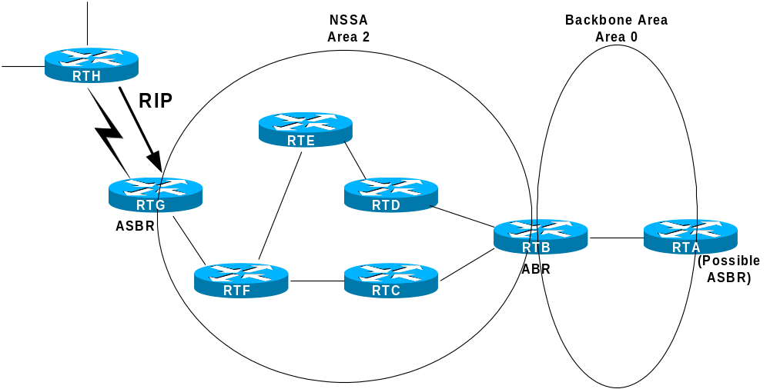
NSSA (Not So Stubby Area)
Rick Graziani graziani@cabrillo.edu

Slide 71
NSSA (Not So Stubby Area)
Relatively new, standards based OSPF enhancement, RFC 1587.
NSSA allows an area to remain a stub area, but carry external routing information (Type 7 LSAs) from its stubby end back towards the OSPF backbone.
ASBR in NSSA injects external routing information into the backbone and the NSSA area, but rejects external routing information coming from the ABR.
The ABR does not inject a default route into the NSSA.
  This is true for a NSSA Stub, but a default route is injected for a NSSA Totally Stubby area.
Note: RFC 1587, “A default route must not be injected into the NSSA as a summary (type-3) LSA as in the stub area case.”
What???
Following scenario is only example of how NSSA works. For the purposes of learning about NSSAs, don’t get hung up on the why’s and what if’s.
Rick Graziani graziani@cabrillo.edu

Slide 72
Default route via RTG
NSSA Stub Area
Area 2 would like to be a stub network.
RTH only supports RIP, so RTG will run RIP and redistribute those routes in OSPF.
Unfortunately, this makes the area 2 router, RTG, an ASBR and therefore area 2 can no longer be a stub area.
RTH does not need to learn routes from OSPF, a default route to RTG is all it needs.
But all OSPF routers must know about the networks attached to the RIP router, RTH, to route packets to them.
Rick Graziani graziani@cabrillo.edu

Slide 73
Default route via RTG
LSA 7
LSA 7
LSA 5
LSA 7
LSA 7
LSA 7s Blocked
LSA 7
LSA 7
NSSA Stub Area (cont.)
NSSA allow external routes to be advertised into the OSPF AS while retaining the characteristics of a stub area to the rest of the OSPF AS.
ASBR RTG will originate Type-7 LSAs to advertise the external destinations.
These LSA 7s are flooded through the NSSA but are blocked by the NSSA ABR.
The NSSA ABR translates LSA 7s into LSA 5s and flood other areas.
Rick Graziani graziani@cabrillo.edu

Slide 74
Default route via RTG
LSA 7
LSA 7
LSA 5
LSA 7
LSA 7
LSA 7s Blocked
LSA 7
LSA 7
Type 7 LSA NSSA External Link Entry
Originated by an ASBR connected to an NSSA.
Type 7 messages can be flooded throughout NSSAs and translated into LSA Type 5 messages by ABRs.
Routes learned via Type-7 LSAs are denoted by either a default “N1” or an “N2” in the routing table. (Relative to E1 and E2).
Rick Graziani graziani@cabrillo.edu

Slide 75
NSSA Generic
Default route via RTG
LSA 7
LSA 7
LSA 5
LSA 7
LSA 7
LSA 7s Blocked
LSA 7
LSA 7
Configuring NSSA Stub Area
Configured for all routers in Area 2:
router ospf 1
network 172.16.2.0 0.0.0.255 area 2
area 2 nssa
Rick Graziani graziani@cabrillo.edu

Slide 76
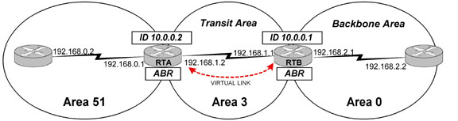
Virtual Links
Rick Graziani graziani@cabrillo.edu

Slide 77
Virtual Links
All areas in an OSPF autonomous system must be physically connected to the backbone area (area 0).
In some cases where this is not possible, you can use a virtual link to connect to the backbone through a non-backbone area.
As mentioned above, you can also use virtual links to connect two parts of a partitioned backbone through a non-backbone area.
The area through which you configure the virtual link, known as a transit area, must have full routing information.
Must be configured between two ABRs.
The transit area cannot be a stub area.
Rick Graziani graziani@cabrillo.edu

Slide 78
Virtual Links
A virtual link has the following two requirements:
  It must be established between two routers that share a common area and are both ABRs.
  One of these two routers must be connected to the backbone.
Doyle, “should be used only as a temporary fix to an unavoidable topology problem.”
Rick Graziani graziani@cabrillo.edu

Slide 79
Virtual Links
The command to configure a virtual link is as follows:
area <area-id> virtual-link <remote-router-id>
RTA(config)#router ospf 1
RTA(config-router)#network 192.168.0.0 0.0.0.255 area 51
RTA(config-router)#network 192.168.1.0 0.0.0.255 area 3
RTA(config-router)#area 3 virtual-link 10.0.0.1
...
RTB(config)#router ospf 1
RTB(config-router)#network 192.168.1.0 0.0.0.255 area 3
RTB(config-router)#network 192.168.2.0 0.0.0.255 area 0
RTB(config-router)#area 3 virtual-link 10.0.0.2
Rick Graziani graziani@cabrillo.edu

Slide 80
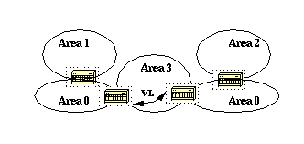
Virtual Links
OSPF allows for linking discontinuous parts of the backbone using a virtual link.
In some cases, different area 0s need to be linked together. This can occur if, for example, a company is trying to merge two separate OSPF networks into one network with a common area 0.
In other instances, virtual-links are added for redundancy in case some router failure causes the backbone to be split into two. (CCO)
Whatever the reason may be, a virtual link can be configured between separate ABRs that touch area 0 from each side and having a common area.
Rick Graziani graziani@cabrillo.edu

Slide 81
Route Summarization
Inter-Area Route Summarization - Area Range
By default ABRs do not summarize routes between areas.
Route summarization is the consolidation of advertised addresses.
This feature causes a single summary route to be advertised to other areas by an ABR.
In OSPF, an ABR will advertise networks in one area into another area.
If the network numbers in an area are assigned in a way such that they are contiguous, you can configure the ABR to advertise a summary route that covers all the individual networks within the area that fall into the specified range.
On the ABR (Summarizes routes before injecting them into different area)
Router(config-router)# area area-id range network-address subnet-mask
area-id - Identifier of the area about which routes are to be summarized. (From area)
Rick Graziani graziani@cabrillo.edu

Slide 82
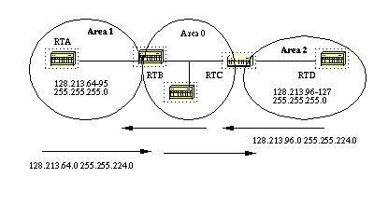
Route Summarization
RTB is summarizing the range of subnets from 128.213.64.0 to 128.213.95.0 into one range: 128.213.64.0 255.255.224.0.
This is achieved by masking the first three left most bits of 64 using a mask of 255.255.224.0.
128.213.64.0/24 - 010 00000
128.213.95.0/24 – 010 11111
-----------------------------------------
128.213.64.0/19 - 01000000
Rick Graziani graziani@cabrillo.edu

Slide 83
Route Summarization
128.213.64.0/24 - 010 00000
128.213.95.0/24 – 010 11111
-----------------------------------------
128.213.64.0/19 - 01000000
RTB
router ospf 100
area 1 range 128.213.64.0 255.255.224.0
Rick Graziani graziani@cabrillo.edu

Slide 84
Route Summarization
128.213.96.0/24 - 011 00000
128.213.127.0/24 – 011 11111
-----------------------------------------
128.213.96.0/19 - 01100000
RTC
router ospf 100
area 2 range 128.213.96.0 255.255.224.0
Rick Graziani graziani@cabrillo.edu

Slide 85
Route Summarization
External Route Summarization - summary-address
When redistributing routes from other protocols into OSPF (later), each route is advertised individually in an external link state advertisement (LSA).
However, you can configure the Cisco IOS software to advertise a single route for all the redistributed routes that are covered by a specified network address and mask.
Doing so helps decrease the size of the OSPF link state database.
On the ASBR only (Summarizes external routes before injecting them into the OSPF domain.)
Router(config-router)# summary-address network-address subnet-mask
Rick Graziani graziani@cabrillo.edu

Slide 86
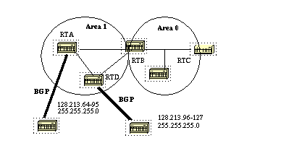
Route Summarization
RTA
router ospf 100
summary-address 128.213.64.0 255.255.224.0
redistribute bgp 50 metric 1000 subnets (later)
RTD
router ospf 100
summary-address 128.213.96.0 255.255.224.0
redistribute bgp 20 metric 1000 subnets (later)
Rick Graziani graziani@cabrillo.edu

Slide 87
Injecting Default Routes into OSPF
By default, 0.0.0.0/0 route is not propagated from the ASBR to other routers.
An autonomous system boundary router (ASBR) can be forced to generate a default route into the OSPF domain.
As discussed earlier, a router becomes an ASBR whenever routes are redistributed into an OSPF domain.
However, an ASBR does not, by default, generate a default route into the OSPF routing domain.
Rick Graziani graziani@cabrillo.edu

Slide 88
Injecting Default Routes into OSPF
The way that OSPF generates default routes (0.0.0.0) varies depending on the type of area the default route is being injected into.
Stub and Totally Stubby Areas
For stub and totally stubby areas, the area border router (ABR) to the stub area generates a summary link-state advertisement (LSA) with the link-state ID 0.0.0.0.
This is true even if the ABR doesn't have a default route.
In this scenario, you don't need to use the default-information originate command.
Rick Graziani graziani@cabrillo.edu

Slide 89
Stub Area
LSA 3
LSA 4
LSA 4
LSA 5
LSA 3
LSA 5
Blocked X
X Blocked
Default route to ABR injected
Stub Area
Area 1
All routers in the area must be configured as “stub” including the ABR:
router ospf 1
area 1 stub
Rick Graziani graziani@cabrillo.edu

Slide 90
Totally Stubby Area
LSA 3
LSA 4
LSA 4
LSA 5
LSA 3
LSA 5
Blocked X
X
X Blocked
Default route to ABR injected
Totally Stubby Area
Area 1
All routers in the area must be configured as “stub” except the ABR “stub no summary”:
ABR: router ospf 1 Other: router ospf 1
area 1 stub no-summary area 1 stub
Rick Graziani graziani@cabrillo.edu

Slide 91
Injecting Default Routes into OSPF
Normal Areas
By default, in normal areas routers don't generate default routes.
To have an OSPF router generate a default route, use the default-information originate command.
This generates an external type-2 link with link-state ID 0.0.0.0 and network mask 0.0.0.0.
This command should only be used on the ASBR.
  Some documentation states this command works only on an ASBR while other documentation states this command turns a router into an ASBR.
Rick Graziani graziani@cabrillo.edu

Slide 92
Injecting Default Routes into OSPF
To have OSPF generate a default route use the following:
router ospf 10
default-information originate [always] [metric metric-value] [metric-type type-value] [route-map map-name]
Rick Graziani graziani@cabrillo.edu

Slide 93
Injecting Default Routes into OSPF
There are two ways to generate a default.
1) default-information originate
If the ASBR already has the default route (ip route 0.0.0.0 0.0.0.0), you can advertise 0.0.0.0 into the area.
2) default-information originate always
If the ASBR doesn't have the route (ip route 0.0.0.0 0.0.0.0), you can add the keyword always to the default-information originate command, and then advertise 0.0.0.0.
You should be careful when using the always keyword. If your router advertises a default (0.0.0.0) inside the domain and does not have a default itself or a path to reach the destinations, routing will be broken.
Rick Graziani graziani@cabrillo.edu

Slide 94
Injecting Default Routes into OSPF
0.0.0.0/0
0.0.0.0/0
0.0.0.0/0
0.0.0.0/0
0.0.0.0/0
0.0.0.0/0
0.0.0.0/0
ASBR
router ospf 1
redistribute static
network 172.16.1.0 0.0.0.255 area 0
default-information originate
ip route 0.0.0.0 0.0.0.0 10.0.0.2
Rick Graziani graziani@cabrillo.edu

Slide 95
Injecting Default Routes into OSPF
No 0.0.0.0/0 route, but propagated anyway or “always”
0.0.0.0/0
0.0.0.0/0
0.0.0.0/0
0.0.0.0/0
0.0.0.0/0
0.0.0.0/0
ASBR
router ospf 1
redistribute static
network 172.16.1.0 0.0.0.255 area 0
default-information originate always
ip route 0.0.0.0 0.0.0.0 10.0.0.2
Rick Graziani graziani@cabrillo.edu

Slide 96
Redistributing External Routes
E1 vs. E2 External Routes
External routes fall under two categories, external type 1 and external type 2.
The difference between the two is in the way the cost (metric) of the route is being calculated.
A type 1 (E1) cost is the addition of the external cost and the internal cost used to reach that route.
The cost of a type 2 (E2) route is always the external cost, irrespective of the interior cost to reach that route.
Type 2 (E2) is the default!
Rick Graziani graziani@cabrillo.edu

Slide 97
Redistributing External Routes
router ospf 1
redistribute routing-protocol metric-type [1|2]
metric-type 1 - A type 1 cost is the addition of the external cost and the internal cost used to reach that route.
redistribute rip [metric value] metric-type 1
metric-type 2 - The cost of a type 2 route is always the external cost, irrespective of the interior cost to reach that route.
redistribute rip [metric value] metric-type 2
Rick Graziani graziani@cabrillo.edu

Slide 98
Router Link States (LSA 1)
Router Link States (LSA1’s) should display all the RouterIDs of routers in that area, including its own.
Link State ID is always the same as the Advertising Router.
ADV Router is the Router ID of the router that created this LSA 1.
Net Link States (LSA 2)
Net Link States (LSA2’s) should display the RouterIDs of the DRs on all multi-access networks in the area and their IP addresses.
Link ID is the IP address of DR on MultiAccess Network.
ADV Router is the Router ID of the DR.
Summary Link States (LSA 3)
Should see networks in other areas and the ABR advertising that route.
Link ID is the IP network addresses of networks in other areas.
ADV Router is the ABR Router ID sending the LSA-3.
Summary ASB Link States (LSA 4)
Routers in non-area 0, should see Router ID of ASBR and its ABR to get there.
Link ID is the Router ID of ASBR
ADV Router is the Router ID of the ABR advertising route
Type-5 AS External Link States (LSA 5)
All Routers should see External networks and the Router ID of ASBR to get there
Link ID is the External Network
ADV Router is the Router ID of ASBR advertising the LSA 5.
Rick Graziani graziani@cabrillo.edu

